Slide 1
EE5630 DSP Classroom Meeting #2
June 8-9, 2020
Yi-Wen Liu, Associate Professor
Dept. Electrical Engineering
National Tsing Hua University

Slide 2
Overview of this semester, latest update
We have done:
13 Video lectures from MIT
23(?) extra videos from YWL
9 HWs
4 streaming sessions
Below are the textbook sections you should prepare for the final exam.
2.7-2.9 Discrete-time Fourier transform
4.2-4.4; 4.6 All about sampling
5.1-5.7: Linear time-invariant system analysis
6.2-6.4, 6.6, 6.8* Structures for discrete-time systems
7.1-7.7, 7.9: IIR and FIR Filter design
* Will be in HW10, due June 14 23:59.
(Sections not included in the final exam are 6.5, 6.7, 7.8)

Slide 3
Upcoming schedules
6/15 (Monday) Streaming #5, over youtube
6/22 (Monday) Final Exam (50%)

Slide 4
Let’s begin this mock exam.

Slide 5
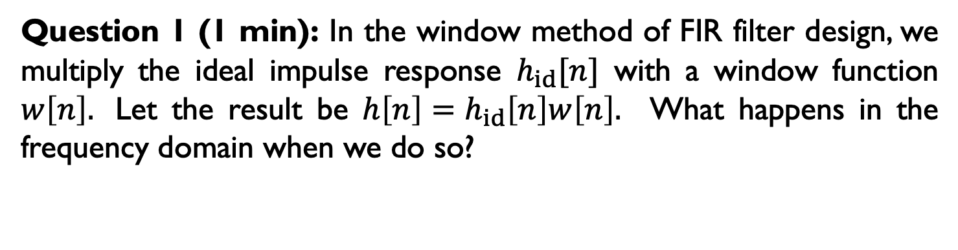
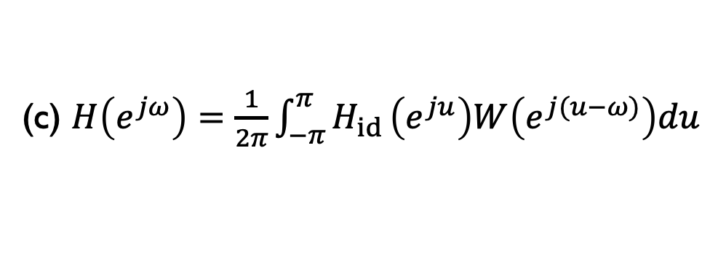
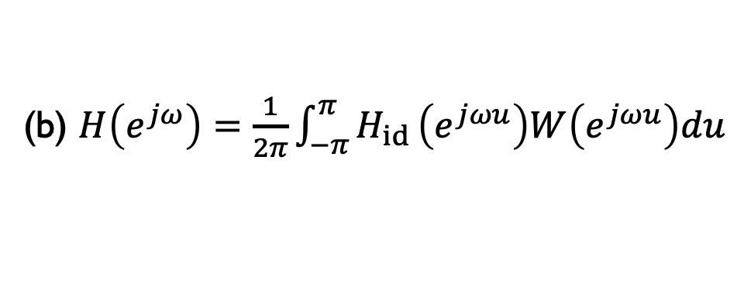
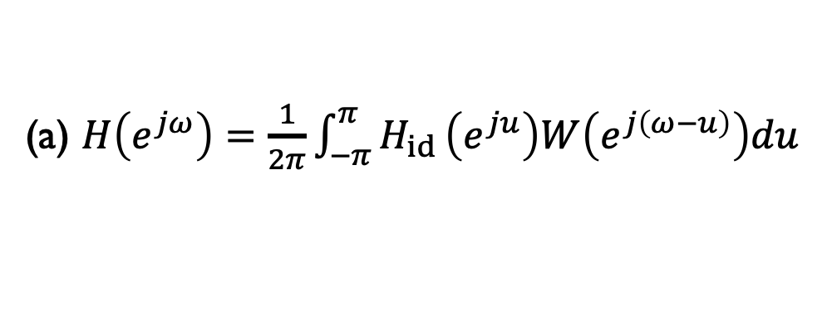
Question 1 (1 min): In the window method of FIR filter design, we multiply the ideal impulse response $h_{id}[n]$ with a window function $w\left[n\right].$ Let the result be $h\left[n\right]=h_{id}\left[n\right]w\left[n\right].$ What happens in the frequency domain when we do so?
(a) $H\left(e^{jω}\right)=\frac{1}{2π}\int_{−π}^{π}{H_{id}}\left(e^{ju}\right)W\left(e^{j\left(ω−u\right)}\right)du$
(b) $H\left(e^{jω}\right)=\frac{1}{2π}\int_{−π}^{π}{H_{id}}\left(e^{jωu}\right)W\left(e^{jωu}\right)du$
(c) $H\left(e^{jω}\right)=\frac{1}{2π}\int_{−π}^{π}{H_{id}}\left(e^{ju}\right)W\left(e^{j(u−ω)}\right)du$
Notes:
My answer is (a)

Slide 6
(a)
(b)
Question 2 (2 min): The figure above shows the magnitude response of an FIR lowpass filter that is designed by the window method. The length of the filter is 33. Which one on the right could be the result if we increase the length to 65 using the same type of window?
(c)
Notes:
Answer: (a)

Slide 7
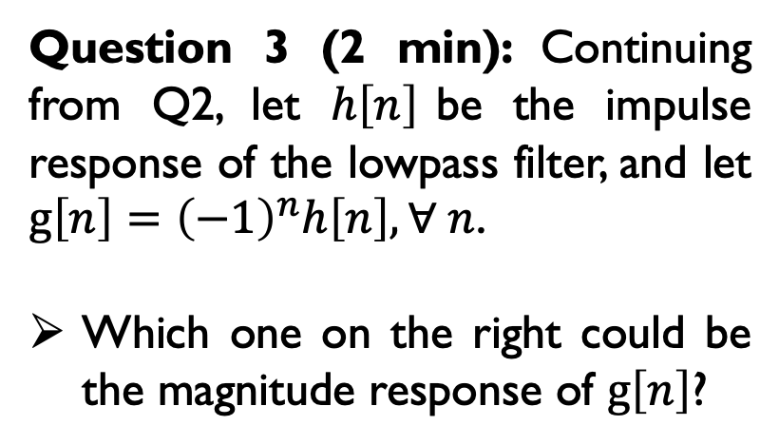
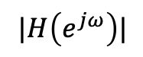
Question 3 (2 min): Continuing from Q2, let $h\left[n\right]$be the impulse response of the lowpass filter, and let $g\left[n\right]={\left(−1\right)}^{n}h\left[n\right], ∀ n$.
Which one on the right could be the magnitude response of $g\left[n\right]$?
(a)
(b)
$$|H\left(e^{jω}\right)|$$
Notes:
Answer: (a)

Slide 8
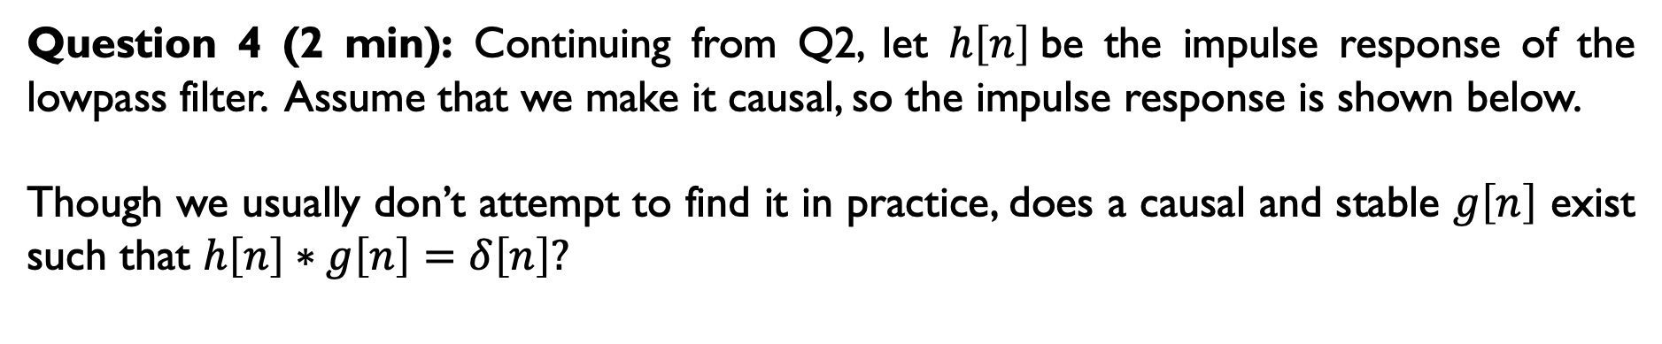
Question 4 (2 min): Continuing from Q2, let $h\left[n\right]$be the impulse response of the lowpass filter. Assume that we make it causal, so the impulse response is shown below.
Though we usually don’t attempt to find it in practice, does a causal and stable $g\left[n\right]$ exist such that $h\left[n\right]∗g\left[n\right]=δ\left[n\right]?$
h[n]
Yes.
No.
Notes:
Answer (b)

Slide 9
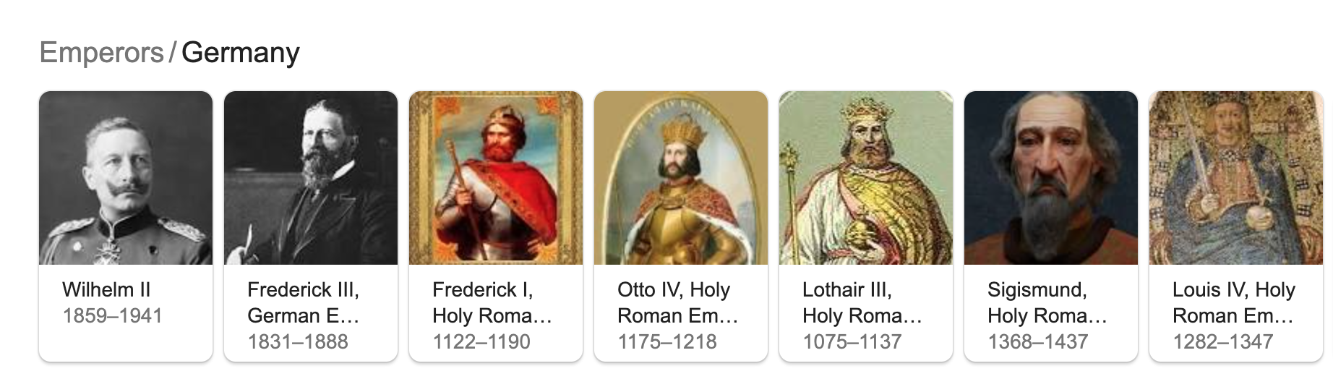
Advertisement:
The final exam may also include Kaiser Family of Windows.

Slide 10
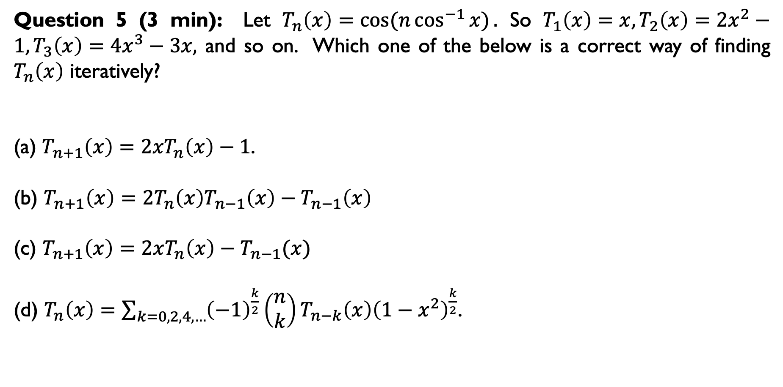
Question 5 (3 min): Let $T_{n}\left(x\right)=cos⁡(n\cos^{−1}{x)}.$ So $T_{1}\left(x\right)=x, T_{2}\left(x\right)=2x^{2}−1, T_{3}\left(x\right)=4x^{3}−3x,$ and so on. Which one of the below is a correct way of finding $T_{n}\left(x\right)$ iteratively?
(a) $T_{n+1}\left(x\right)={2xT}_{n}\left(x\right)−1$.
(b) $T_{n+1}\left(x\right)=2T_{n}\left(x\right)T_{n−1}\left(x\right)−T_{n−1}\left(x\right)$
(c) $T_{n+1}\left(x\right)=2xT_{n}\left(x\right)−T_{n−1}(x)$
(d) $T_{n}\left(x\right)=\sum_{k=0,2,4,…}{{\left(−1\right)}^{\frac{k}{2}}\left(\begin{matrix}n \\ k\end{matrix}\right)}T_{n−k}\left(x\right){\left(1−x^{2}\right)}^{\frac{k}{2}}$.
Notes:
Answer c (d is actually correct, too)

Slide 11
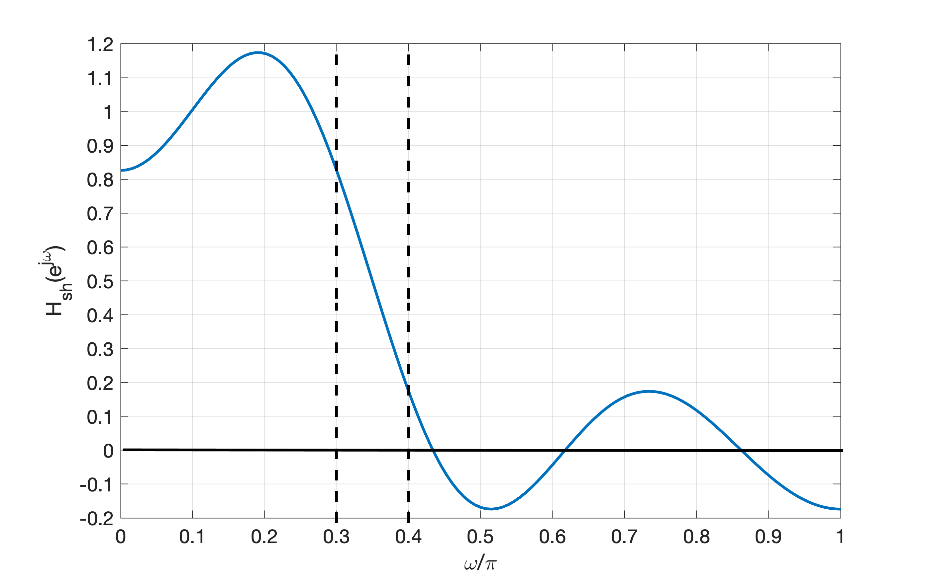
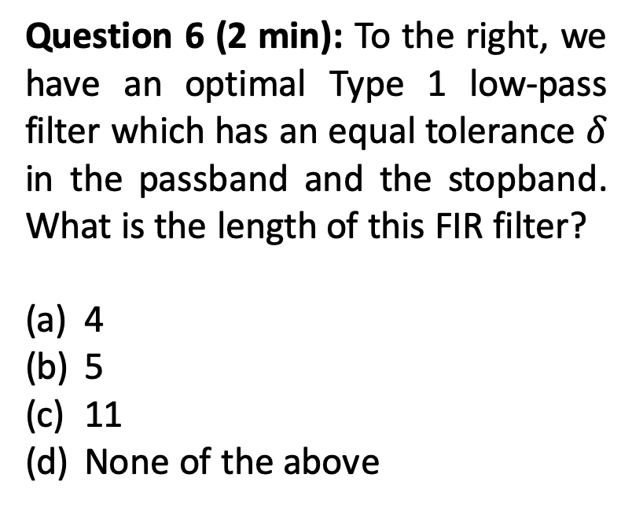
Question 6 (2 min): To the right, we have an optimal Type 1 low-pass filter which has an equal tolerance $δ$ in the passband and the stopband. What is the length of this FIR filter?
4
5
11
None of the above
Notes:
Answer c or d should both count as correct, because of the ambiguity in whether L = 4 or 5.

Slide 12

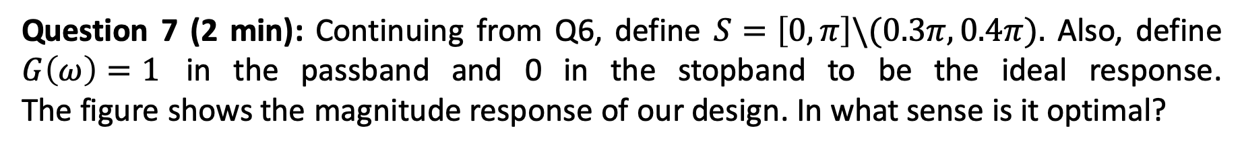
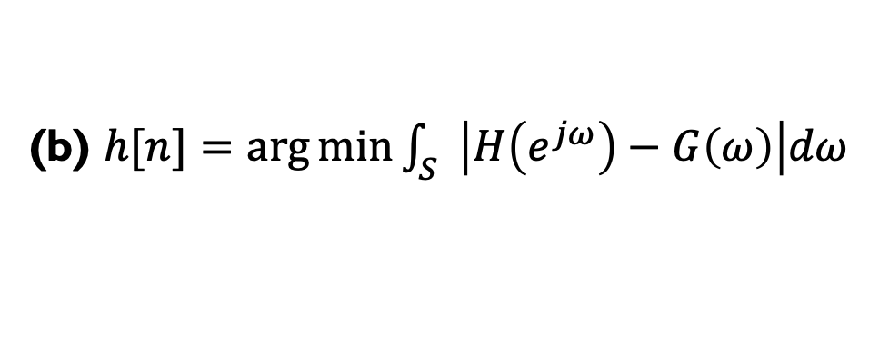
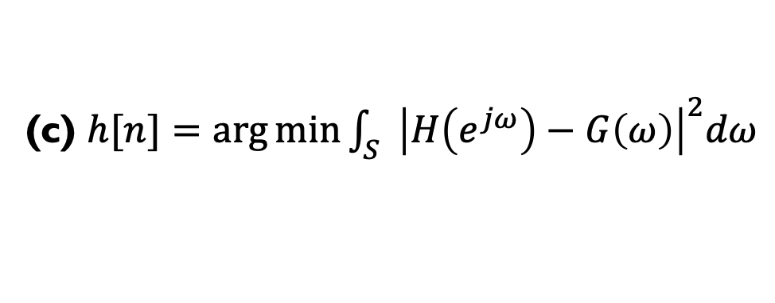
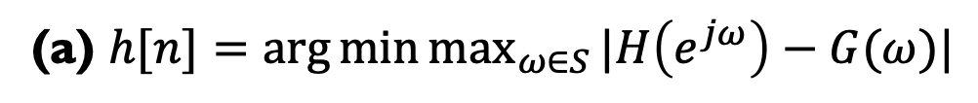
Question 7 (2 min): Continuing from Q6, define $S=\left[0,π\right]\backslash (0.3π,0.4π).$ Also, define $G\left(ω\right)=1$ in the passband and 0 in the stopband to be the ideal response. The figure shows the magnitude response of our design. In what sense is it optimal?
(a) $h[n]=\arg{\min_{}{\max_{ω∈S}{|H\left(e^{jω}\right)−G(ω)|}}}$
(b) $h[n]=\arg{\min_{}{\int_{S}{\left|H\left(e^{jω}\right)−G\left(ω\right)\right|dω}}}$
(c) $h[n]=\arg{\min_{}{\int_{S}{{\left|H\left(e^{jω}\right)−G\left(ω\right)\right|}^{2}dω}}}$
Notes:
Answer a

Slide 13
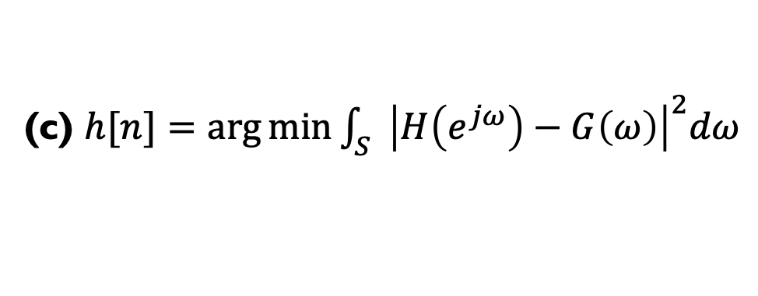
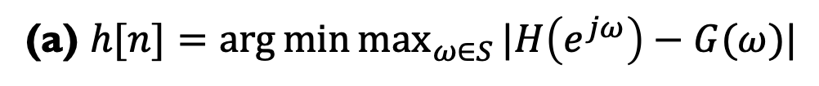
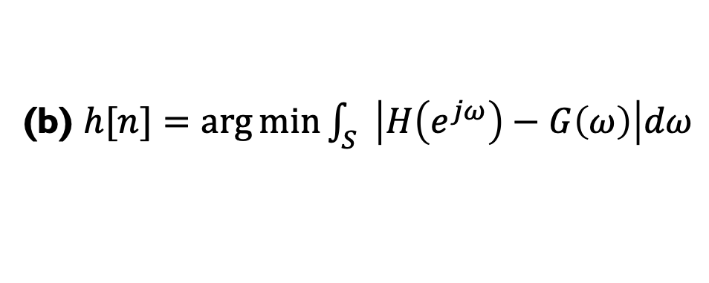
Advertisement:
These three options are examples of optimization problems.
#MinimaxProblem, #H-infinity
(a) $h[n]=\arg{\min_{}{\max_{ω∈S}{|H\left(e^{jω}\right)−G(ω)|}}}$
(b) $h[n]=\arg{\min_{}{\int_{S}{\left|H\left(e^{jω}\right)−G\left(ω\right)\right|dω}}}$
#CompressiveSensing, #L1optimization.
(c) $h[n]=\arg{\min_{}{\int_{S}{{\left|H\left(e^{jω}\right)−G\left(ω\right)\right|}^{2}dω}}}$
#LeastSquareApproximation

Slide 14
Question 8: Explain why these two direct forms (namely, I and II) are equivalent?
Question 9: Can you draw the transposed form for the above?
Figures: from ccrma.Stanford.edu/~jos

Slide 15
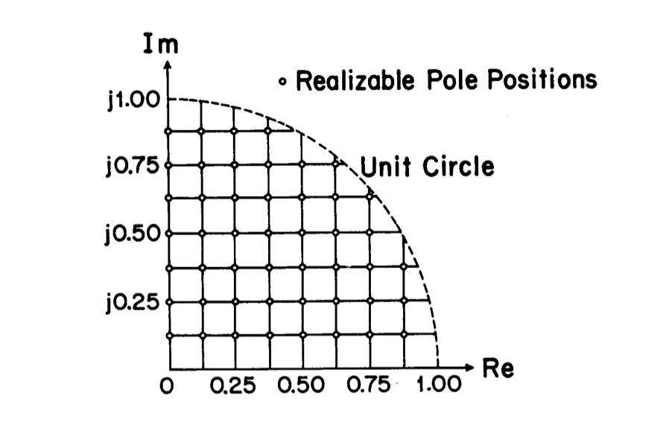
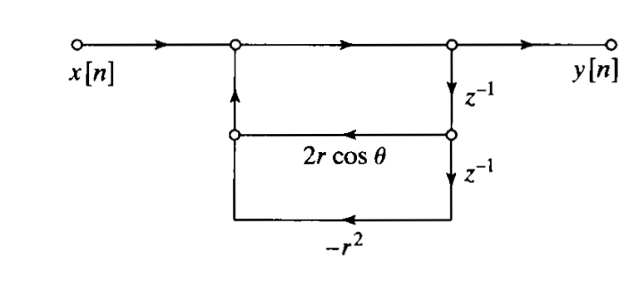
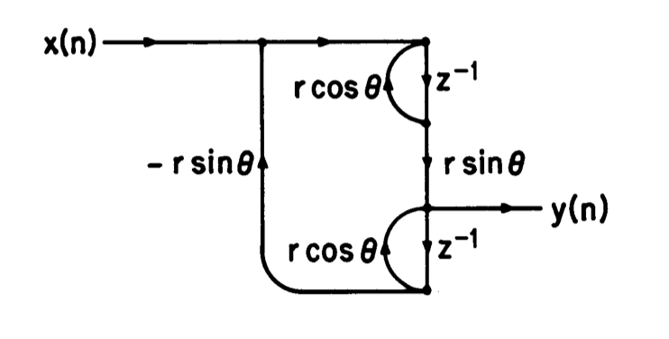
Question 10 (1 min): Due to coefficients quantization, to the right is a list of “realizable pole positions” of a second order system. Which structure below can achieve this?
(a)
(b)
Notes:
Answer (b)

Slide 16
Question 11: To have this “uniform resolution”, how many bits should used to represent each multiplier -- $r\cos{θ}$or $r\sin{θ}$?
8,
4,
3.
Notes:
Answer: b or c can both be correct, depending upon if II, III quadrant poles are also desired.

